Slide 1
Predicting Political Election Outcomes at the County Level
Team 12: Gurpal Kundi, Roy Minato, Shou Shimaya

Slide 2
Project Objective
Predict political election outcomes at the county level from 1990 to 2020 for U.S. presidential, senate, and governor elections by using social, demographic, economic, and previous election data
Explore which features have the most influence on the election outcome.

Slide 3
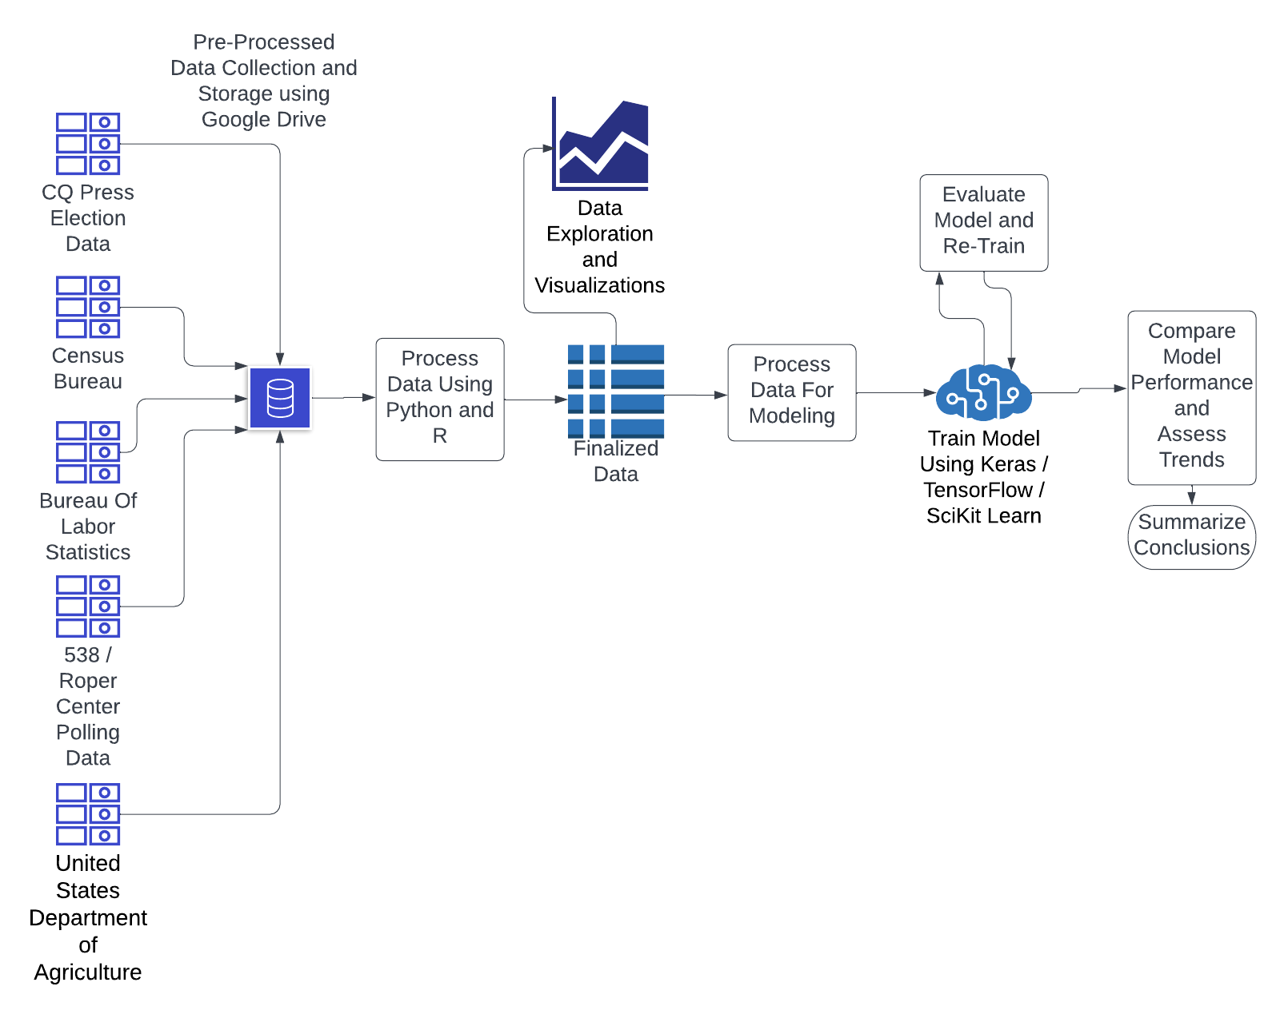
Technical Overview

Slide 4



Data Sources
→ Election data on the county level (1990-2020)
→ State level Presidential polling averages (1992-2020)
→ State level Senatorial/Gubernatorial polls (1990-2020)

Slide 5




→ County/National level unemployment rates (1990-2020)
→ National GDP growth and annual change (1990-2020)
→ County level educational attainment rates (1990-2020)
→ Annual county level demographic data (1990-2020)
Race and sex combination populations
Age group populations

Slide 6
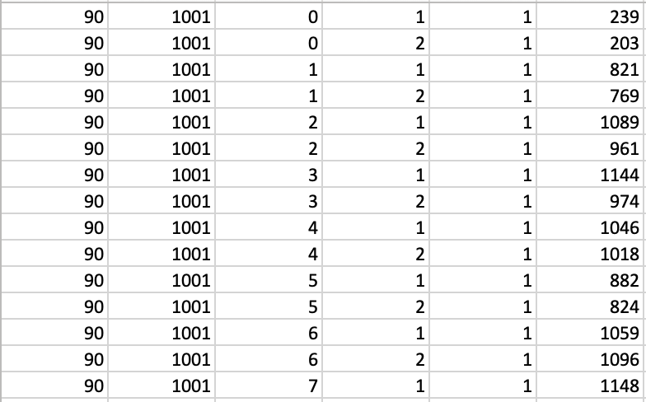
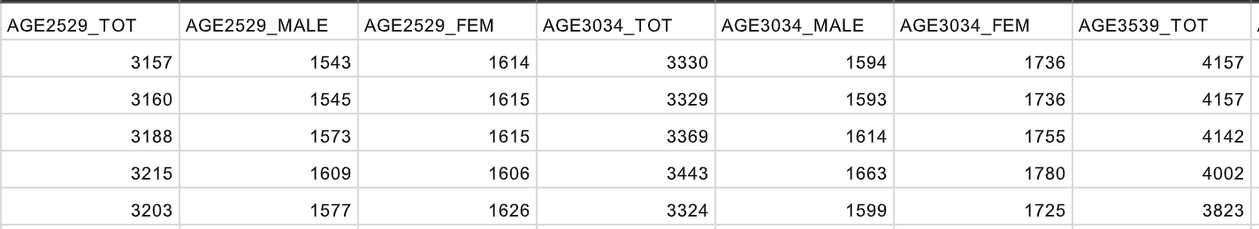
Data Wrangling & Joining
Datasets from the same source usually change in how recorded data is structured over time.
Earlier weeks spent wrangling all the data for a set of features into one table for easy joining.
Data were joined into a combined file by joining tables on state, county, and year columns.

Slide 7
Data Description & Management
Features :
Previous 3 elections outcomes
State polling data
Party incumbency status
County race/sex combination populations
County educational attainment rates
County 5-year age group populations
County/National unemployment rates
National GDP growth rate and annual change
Response Variable : Party that won the election at county level (‘D’ or ‘R’)
Raw datasets, wrangled tables, and code are stored locally and on Google Drive.

Slide 8
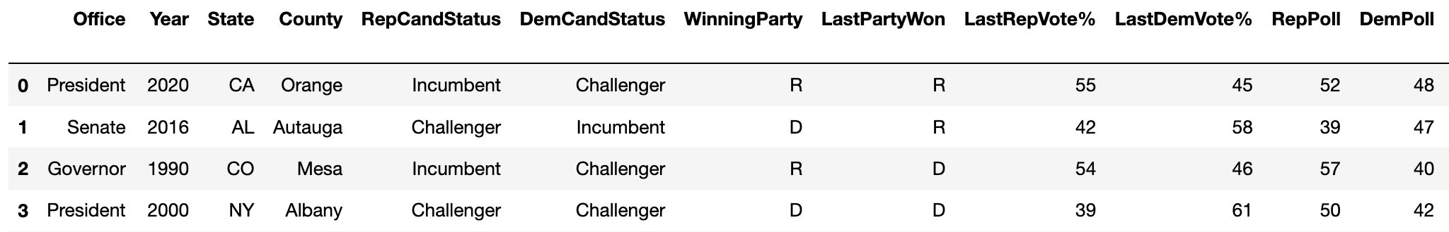
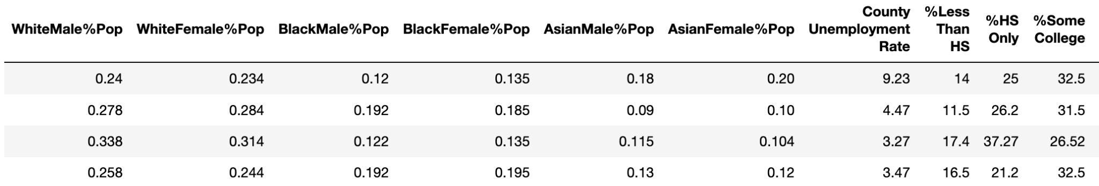
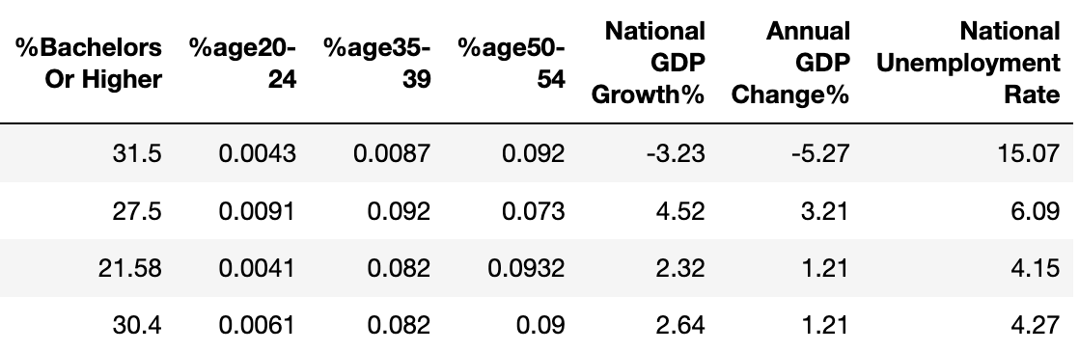
Joined dataset is 74500 x 83

Slide 9
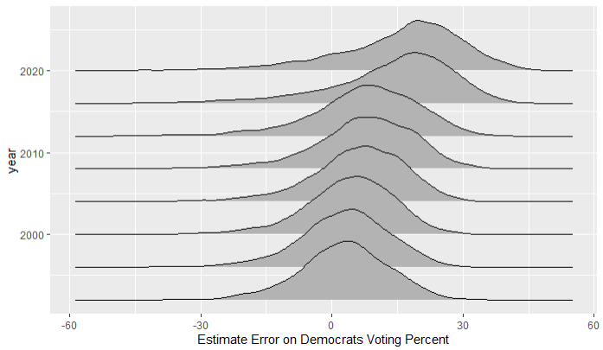
President Election Polling Error Over Time
Notes:
df <- df %>%
mutate(poll_error = DemPoll / (DemPoll + RepPoll) * 100 - demvotesmajorpercent)
df_pres <- df %>%
filter(office == "President")
ggplot(df_pres, aes(x=poll_error, y = year, group = year)) +
geom_density_ridges() +
xlab("Estimate Error on Democrats Voting Percent") +
ggtitle("Poll Error")

Slide 10
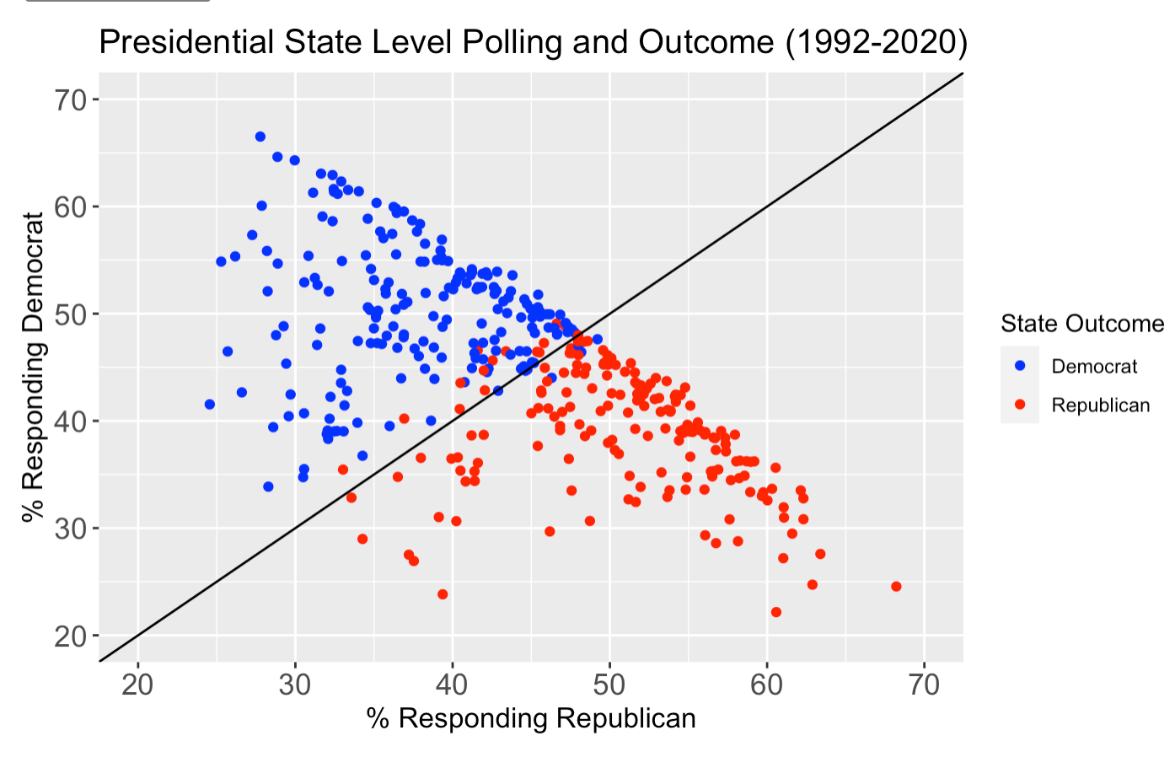

Slide 11
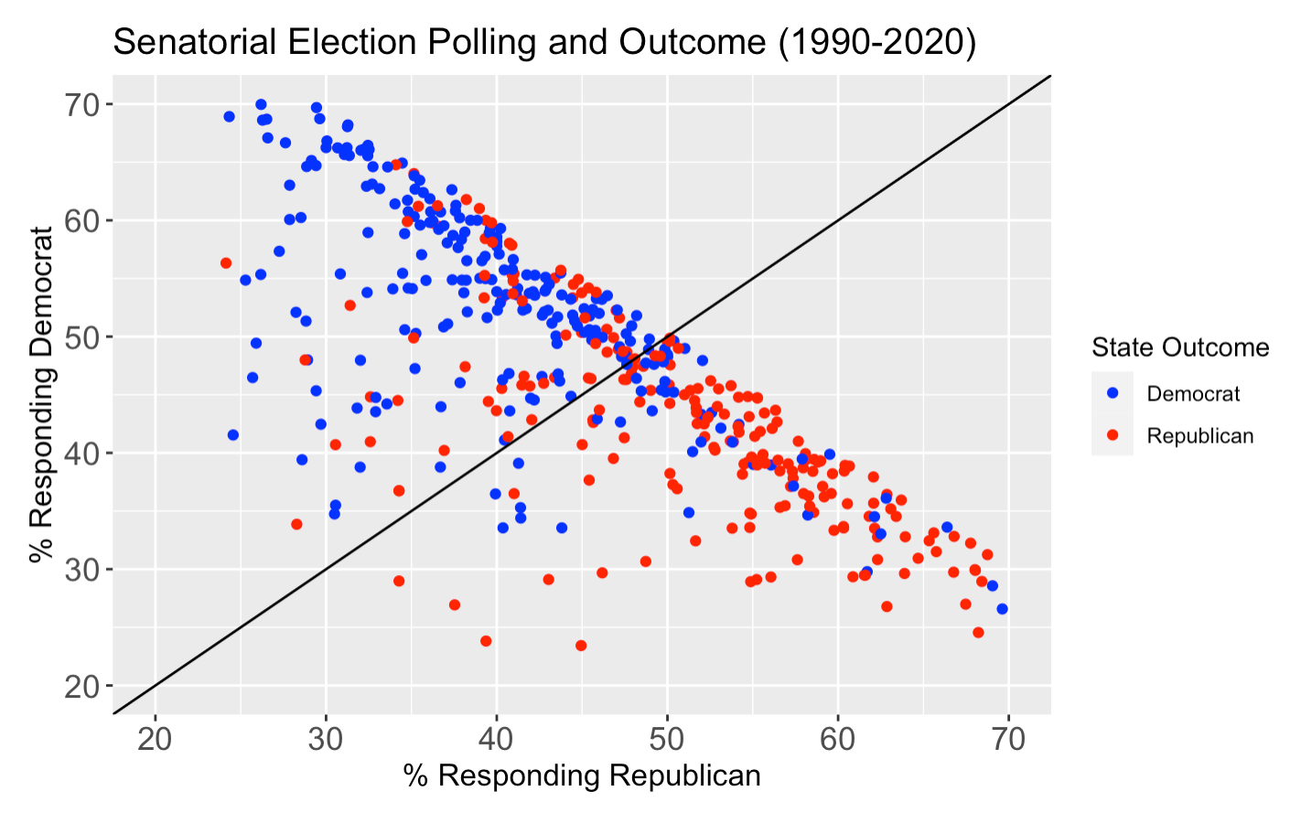

Slide 12
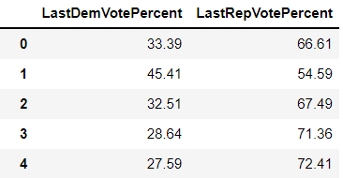
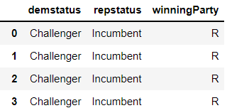
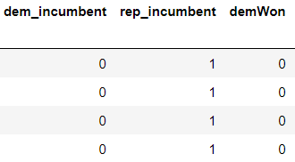
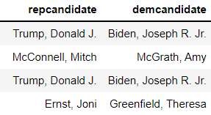
Setting up Data for Machine Learning
74495 x 78

Slide 13
Binary Classification ML Methods
Given our response variable is a binary outcome (either a Democratic or Republican win) we will attempt several classification models including: Logistic Regression, MLP, Random Forest, Boosting
We will compare each model against a baseline model that only uses the previous election result
These models do not take into account the time series nature of our data
Our dataset will attempt to address this by including as predictors past election outcomes and voting percentages
Tools: Python SciKit-Learn

Slide 14
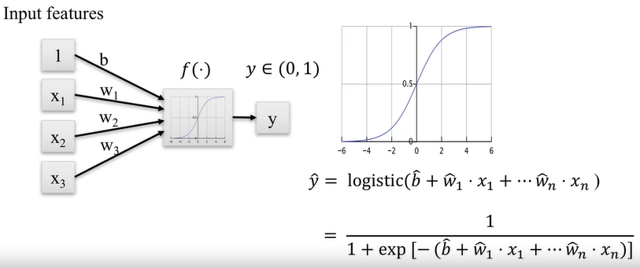
Logistic Regression Review
Model Objective:
Minimize cross-entropy loss using optimization techniques such as SGD
Violated Assumptions:
Multi-collinear features
No linear relationship between the logit of the response and each feature (not linearly separable)

Slide 15
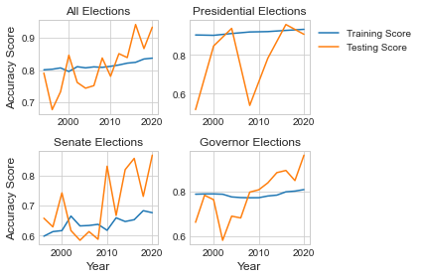
Scikit-Learn LogisticRegression Class

Slide 16
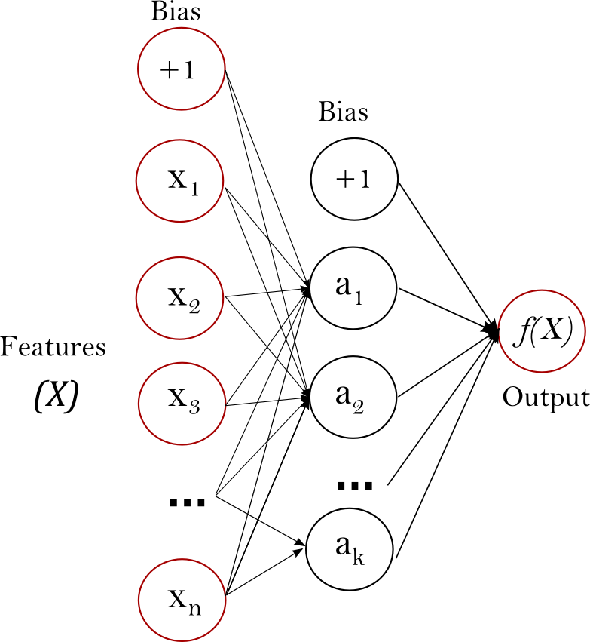
Logistic Regression Using MLP
Advantages:
Capability to learn non-linear models
Disadvantages:
Random weight initializations can lead to different validation accuracy
Requires tuning hyperparameters
Sensitive to feature scaling (use Scikit StandardScaler)

Slide 17
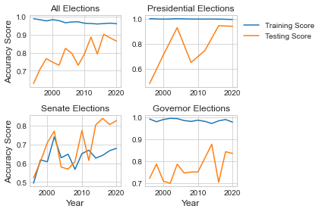
Scikit-Learn MLPClassifier

Slide 18
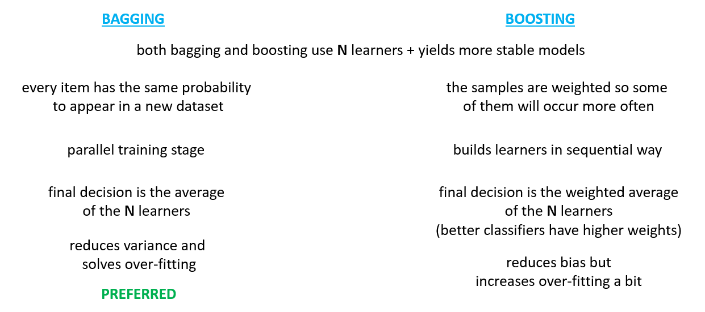
Ensemble Methods Using Decision Trees as Learners

Slide 19
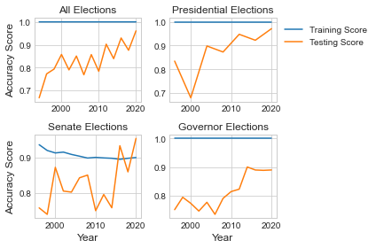
Scikit-Learn Random Forest Classifier

Slide 20
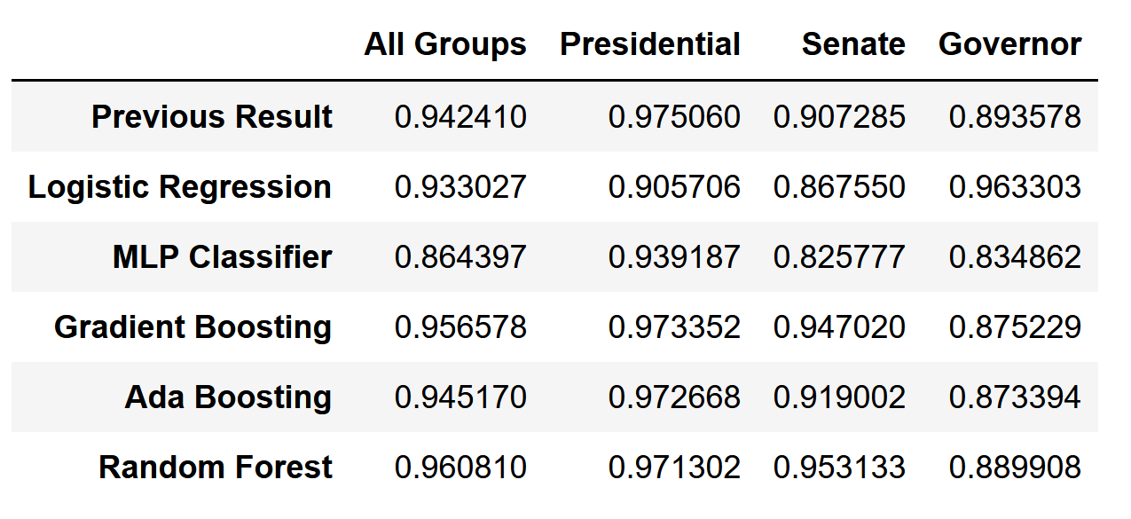
Comparison Of Accuracy for 2020 Election Forecast

Slide 21
Model Results
Highest accuracy models:
All Elections: Random Forest
Presidential Election: Gradient Boosting
Senate Election: Random Forest
Governor Election: Logistic Regression
The best overall model was the Random Forest Ensemble

Slide 22
Statistical Tests on Logistic Regression for President Election
Most important Features (p < 2e-16):
Democrats Vote Percentage in the previous election
Population gender and race distribution
Polls of Democrats and Republicans
GDP Growth
Annual GDP Growth
Population education level distribution
Interaction term between year since 1990 and poll results
Significant Features (p < 0.01):
Age distribution (1.792e-12)
Incumbent statuses (1.186e-06)
County specific unemployment rate (1.35e-06)
National unemployment rate (1.81e-06)
Democrats Vote Percentage 2 elections ago (5.94e-06)
Democrats Vote Percentage 3 elections ago (0.008053)

Slide 23
Statistical Tests on Logistic Regression for Senate Election
Most important Features (p < 2e-16):
Democrats Vote Percentage in the previous election
Democrats Vote Percentage 2 elections ago
County specific unemployment rate
GDP Growth
National Unemployment Rate
Winning Party in the previous election
Winning Party in 3 elections before
Age distribution
Population gender and race distribution
Incumbent statuses for Democrats and Republicans
Population education level distribution
Polls of Democrats and Republicans
Significant Features (p < 0.01):
Year since 1990 (1.44e-12)
Interaction term between year since 1990 and poll results (8.158e-06)
Office Matching Outcome (6.29e-4)

Slide 24
Statistical Tests on Logistic Regression for Governor Election
Most important Features (p < 2e-16):
Democrats Vote Percentage in the previous election
GDP Growth
Incumbent status of Democrats and Republicans
National Unemployment
Age distribution
Population gender and race distribution
Polls of Democrats and Republicans
Significant Features (p < 0.01):
Democrats Vote Percentage 3 elections ago (2.73e-14)
Population education level distribution (9.62e-14)
Winning Party of the previous election (6.29e-13)
Year since 1990 (3.49e-10)
Winning Party in 3 elections before (2.31e-08)
County specific unemployment rate (4.57e-08)
Matching outcomes (3.91e-06)
Democrats Vote Percentage 2 elections ago (2.38e-05)
Interaction term between year since 1990 and poll results (2.668e-05)
Annual GDP Growth (6.37e-04)

Slide 25

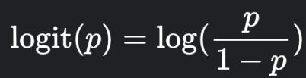
Interpreting Coefficients for Logistic Regression Example
Coefficient for presidential election that indicates the percentage of population with bachelor’s degree:
β = 0.09367071
Given all other variables, when the percentage of population with bachelor’s degree increases by 1, the expected odds of Democrats winning the election increases by a factor of e^β = 1.098198

Slide 26
Conclusions
Even given previous results and polling, there are significant social, demographic, and economic factors for predicting election results
There are differences for each election type
Presidential elections had highest accuracy, and it relies less on social, demographic, and economic factors, perhaps because the poll results was more accurate
Governor elections are hardest to predict
Senate elections are the “noisiest”, perhaps because they occur more frequently and are subject to higher turnover

Slide 27
Continuing Investigations
Use models that deal with time dependency of the observations:
Recurrent Neural Networks (LSTM with PyTorch or Tensorflow)
Generalized Linear Mixed-Effects Models (lme4 package in R)
Incorporate other known dependencies:
Spatial dependency between adjacent counties
“Similar counties have similar results”
Take into account X-factors during election years
Financial crises, pandemics, etc.
Include other types of elections
Test on upcoming elections

Slide 28
THANK YOU

